Slide 1
WEATHER APP
TS- WEB/CC/AI TRACK CAPSTONE PROJECT
Presented By:
1. Miss Swetha Reddy – CMR Engineering College (CMREC)
2. Miss Srija – CMR Engineering College (CMREC)
3. Miss Pravalika – CMR Engineering College (CMREC)
4. Miss Sathvika – CMR Engineering College (CMREC)
Guided By: Ankit Dixit

Slide 2
OUTLINE
Abstract
Problem Statement (Should not include solution)
Aims , Objective & Proposed System/Solution
System Design
System Development Approach(Technology Used)
Algorithm & Deployment
Conclusion
References
Future Scope

Slide 3
Abstract
Weather forecasting is the prediction of the state of the atmosphere for a given location using the application of science and technology. This includes temperature, rain, cloudiness, wind speed, and humidity. Weather warnings are a special kind of short-range forecast carried out for the protection of human life. Weather warnings are issued by the governments throughout the world for all kinds of threatening weather events including tropical storms and tropical cyclones depending upon the location. The forecast may be short-range or Long-range. It is a very interesting and challenging task.
This report provides a basic understanding of the purpose and scope of weather forecasts, the basic principles and the general models developed for forecasting.

Slide 4
Problem Statement
"Develop a user-friendly mobile weather application that provides accurate and up-to-date weather information to users based on their current location or a specified location. The app should offer a clean and intuitive user interface, display real-time weather conditions, forecasts, and other relevant meteorological data, and allow users to customize their preferences. Additionally, it should provide alerts for severe weather conditions and ensure data privacy and security for user locations. The goal is to create a reliable and efficient weather app that enhances user experience and helps individuals make informed decisions based on weather forecasts."

Slide 5
Proposed Solution
"Our weather app aims to provide a comprehensive and user-friendly solution for accessing weather information”. Key features of our app include:
Accurate Weather Data
Location-Based Services
Real-Time Updates
Detailed Forecasts
Interactive Maps

Slide 6
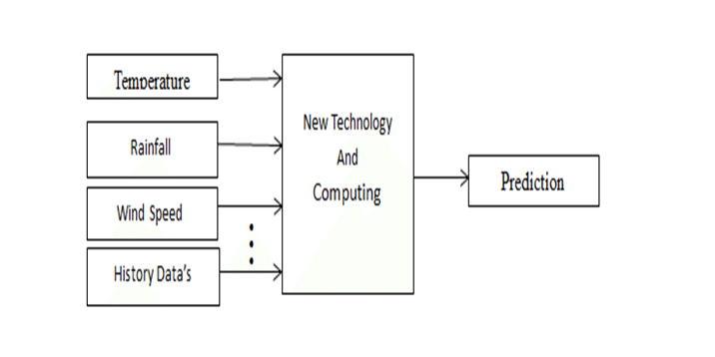

System Architecture

Slide 7
System Deployment Approach
Environment Setup:
Establish the infrastructure for hosting your app, including servers, databases, and any necessary cloud services. Choose a reliable hosting provider or cloud platform that aligns with your scalability and performance requirements.
Deployment Pipeline:
Implement a continuous integration/continuous deployment (CI/CD) pipeline for automating the deployment process . Set up version control and source code repositories to manage your app's codebase.
Development Environment:
Create separate development, testing, and staging environments to isolate development work from production. Developers should use these environments for coding, testing, and debugging.
Testing and Quality Assurance:
Perform thorough testing, including unit tests, integration tests, and user acceptance testing (UAT).Identify and fix bugs and issues before moving to production.
Scalability and Load Testing:
Conduct load testing to ensure your app can handle expected traffic loads . Implement auto-scaling mechanisms to dynamically allocate resources based on demand.

Slide 8
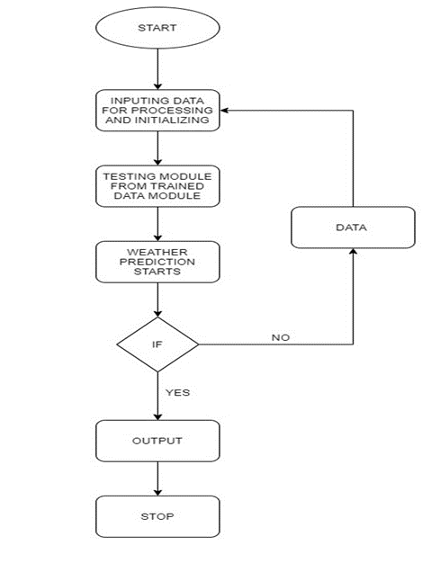
Algorithm & Deployment

Slide 9
THANK YOU

